Slide 1
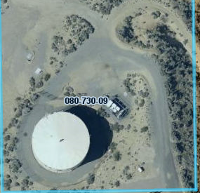
WSUP20-0016 Lemmon Valley Tower
Washoe County Board of Adjustment
December 3, 2020

Slide 2
Request
To construct a 50-foot tall in-ground monopole wireless tower replacing an existing tower located on the Truckee Meadows Water Authority (TMWA) water tank
The proposal also requests varying the landscaping and parking requirements by not requiring any additional landscaping or a paved parking space

Slide 3
Site Analysis
The parcel has a regulatory zone of Public and Semi-Public Facilities (PSP) and the allowed building height is 65 feet
The 1-acre site is vacant except for the TMWA water tank, the existing tower on the tank and tower equipment
The 1-acre parcel is surrounded by a 46-acre parcel (APN: 080-730-29) and a 60-foot tall Verizon tower, a residence and outbuildings are located on the parcel

Slide 4
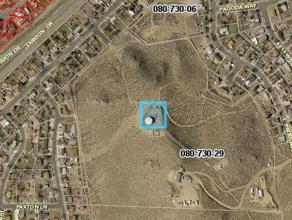
TMWA tank
Verizon tower
Residence

Slide 5
Special Use Permit Requirements
The tower is classified as a commercial facility, which is permitted in PSP with a special use permit (SUP) per WCC 110.302.05.3.
The SUP allows the BOA to vary standards and the applicant is requesting to waive the landscaping and paved parking space requirements.

Slide 6
Analysis
The proposed 50 ft. tower will be constructed northwest of the tank on the ground and the existing tower on the TMWA water tank will be removed
The existing equipment pad will remain in the same location and the equipment will be updated with new technology
The wireless coverage will improve with the new tower and updated equipment and will further assist in emergency communications, including first responders.

Slide 7
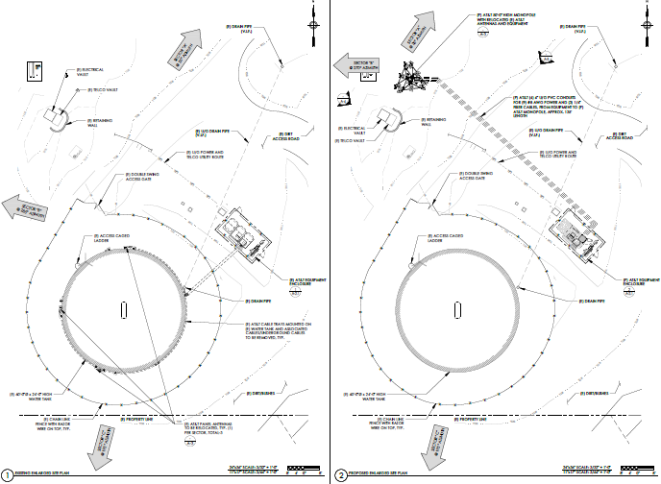
New 50 ft Monopole
Equipment area
Existing towers

Slide 8
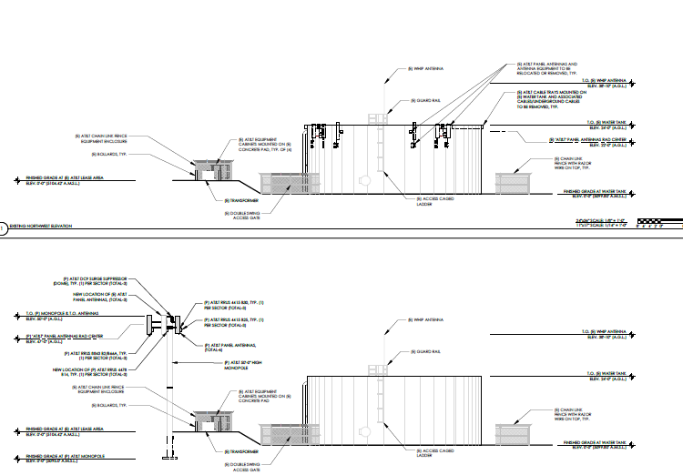

Slide 9
Analysis
The monopole and antennas will be painted to match the surrounding landscape
The tower will be used only by AT&T
Approximately 500 sq. ft. of the 1-acre site will be disturbed to construct the tower

Slide 10
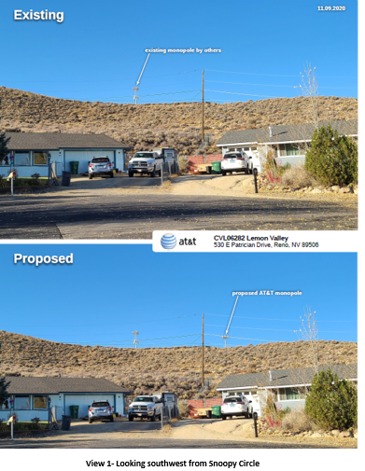

Slide 11
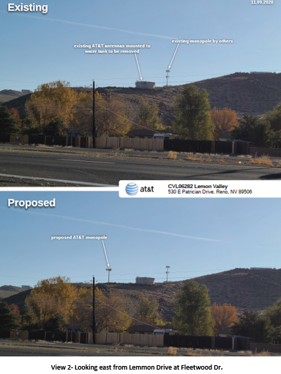

Slide 12
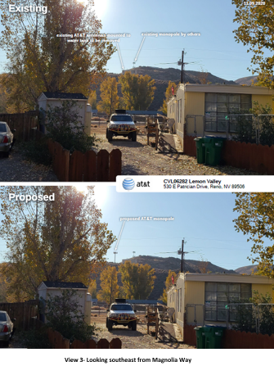

Slide 13
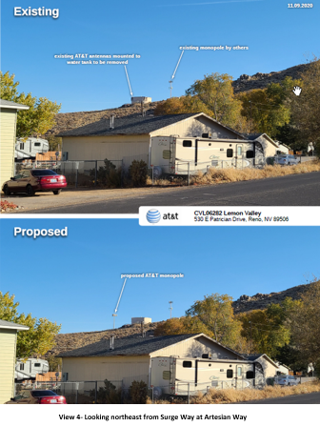

Slide 14
Public Notice & CAB
Public notice was sent to 197 property owners
The North Valleys CAB meeting was held on November 9, 2020, through Zoom and the CAB unanimously recommended approval
There were questions concerning:
• Coverage
• Timeframe for completing the tower

Slide 15
Reviewing Agencies
Various agencies reviewed the application, their comments are included in the staff report
Agencies with conditions, are included in the Conditions of Approval

Slide 16
Special Us Permit Findings
1. Consistency;
2. Improvements;
3. Site Suitability; and
4. Issuance Not Detrimental
Staff is able to make all the required findings, as detailed in the staff report

Slide 17
Possible Motion
I move that, after giving reasoned consideration to the information contained in the staff report and information received during the public hearing, the Washoe County Board of Adjustment approve with conditions Special Use Permit Case Number WSUP20-0016 for AT&T Mobility having made all findings in accordance with Washoe County Code Section 110.810.30 and Section 110.324.75, subject to the conditions contained in Exhibit A to the Staff Report.

